Slide 1
Facial Expression of Emotion
PSY 8993 Bayesian Analysis
5/2/2014
Windy Torgerud

Slide 2


Slide 3
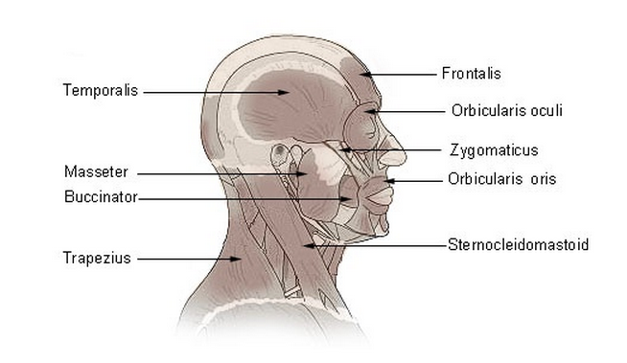
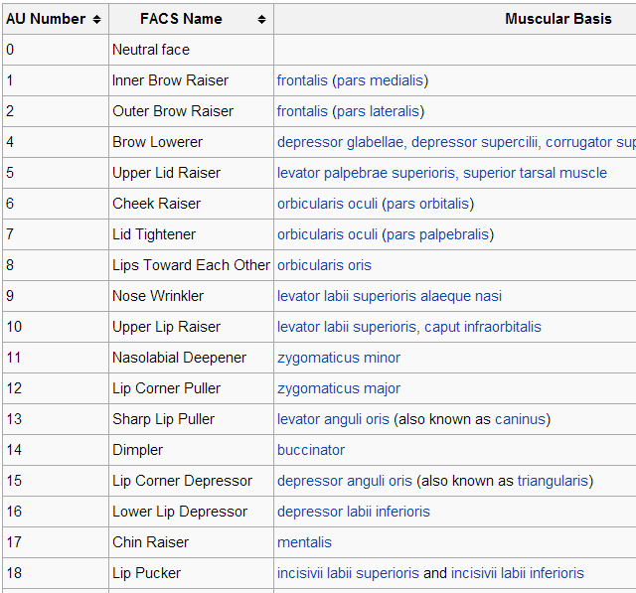

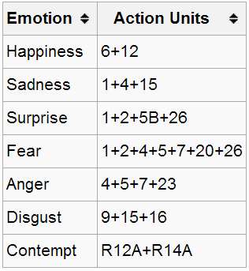

Slide 4

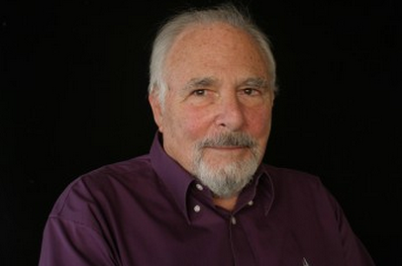
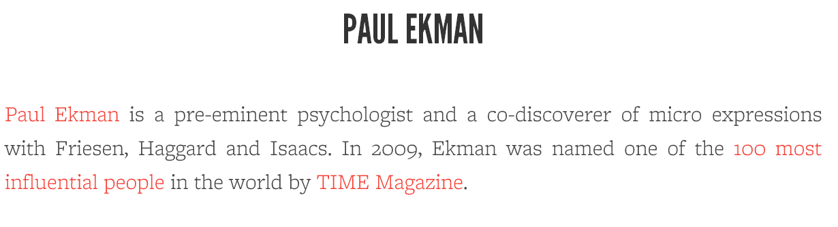
Notes:
Discovered that these facial expression of emotion is consistent across cultures

Slide 5
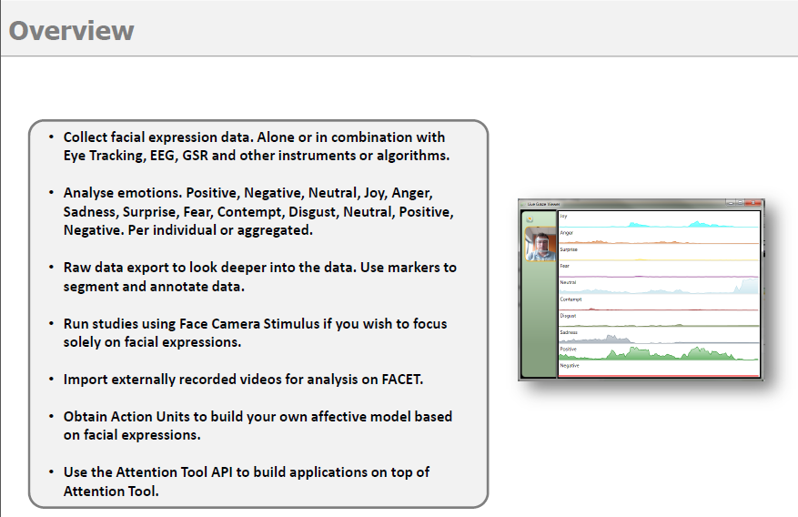


Slide 6
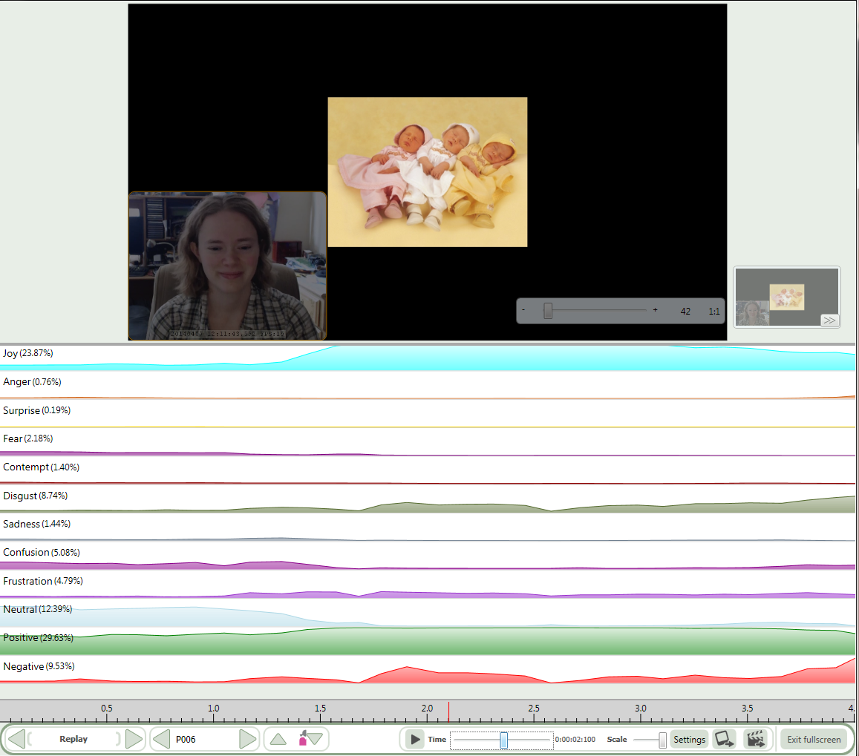
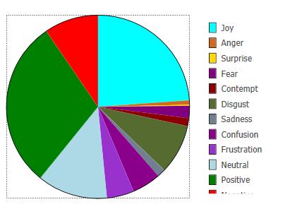
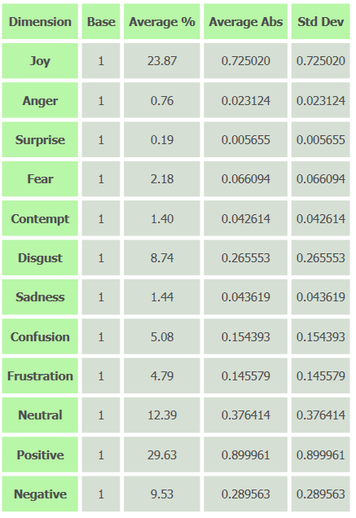
Notes:
Experiment setup – Web camera on face. Participant views stimulus on second monitor.
Joy – Yay babies
Notice Pos Neg and Neutral on bottom. Data analysis done on those

Slide 7
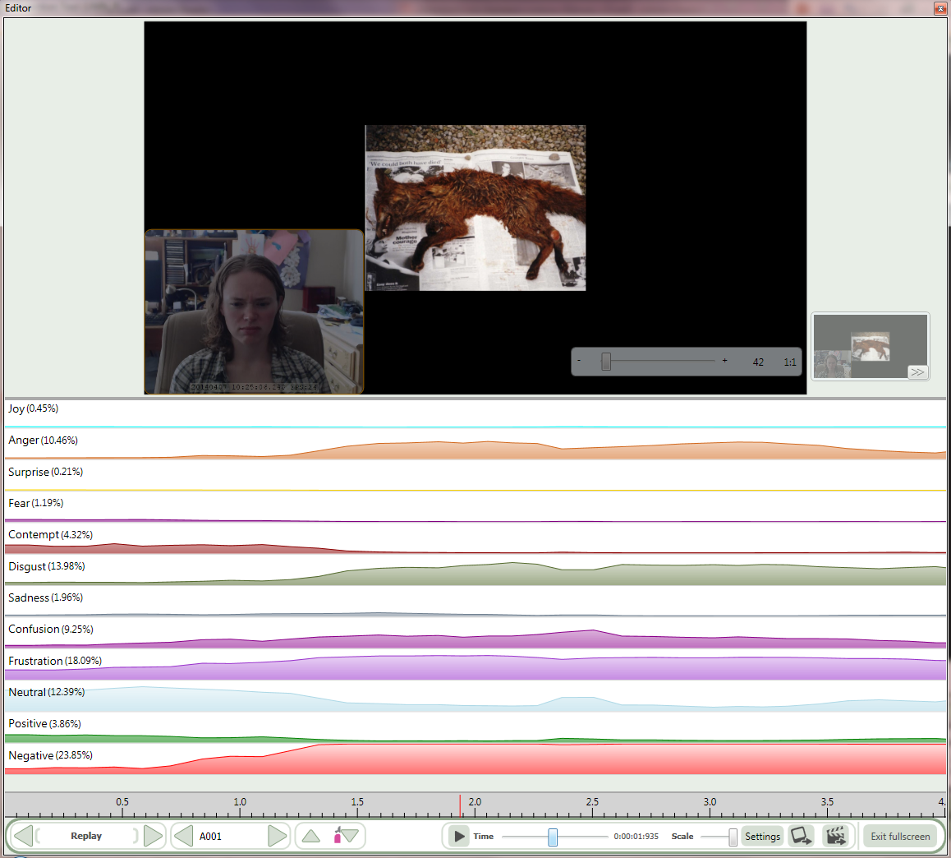
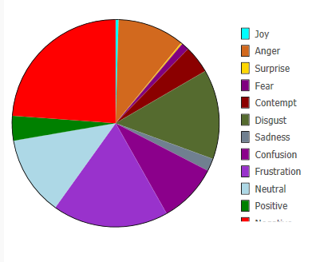
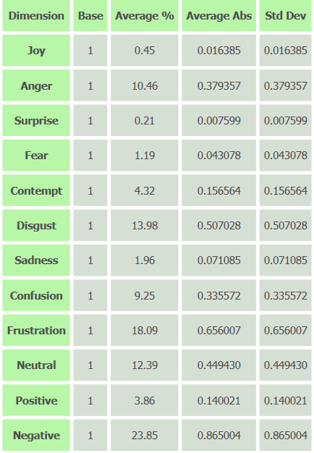
Notes:
And now, disgust.
Point out the timecourse of the emotions. Point out average vs max

Slide 8

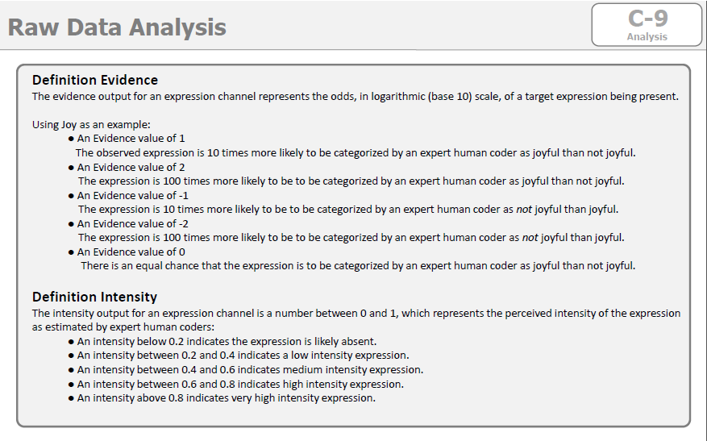
Notes:
Drill in difference btwn evidence and intensity
Point out the scale. Multiple times. Evidence -3 to 3.
Intensity 0 to 1

Slide 9
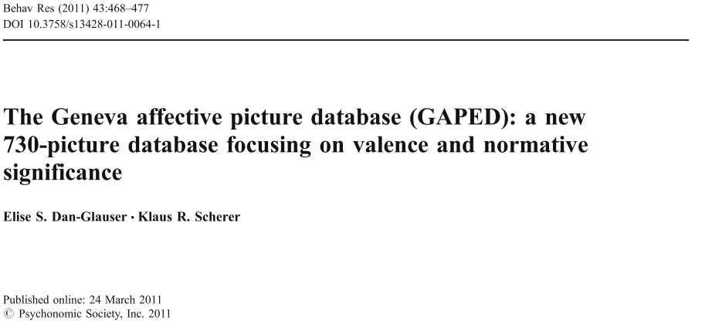
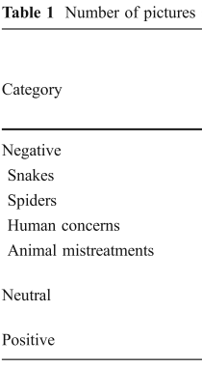
Notes:
Their goal. Create database of images that researchers can pick and choose from for emotion evoking stimuli for their studies.
Categories: Point out Neg Neutral and Positive. Remind about the Neg, Neutral, and Pos categories from the Attn tool.

Slide 10
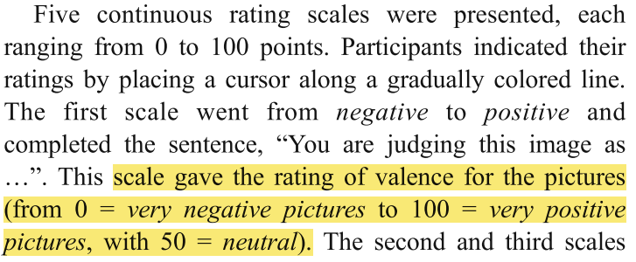
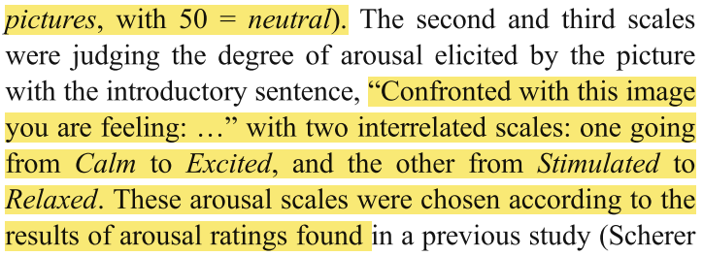
Valence
Arousal
Notes:
60 Undergrads viewing images. Images broken into chunks. Each person rating 182 images. 39 images rated by all participants to be able to compare groups.
4 sec/image
Define valence and arousal. Point out scale. 0 to 100

Slide 11

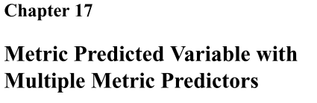
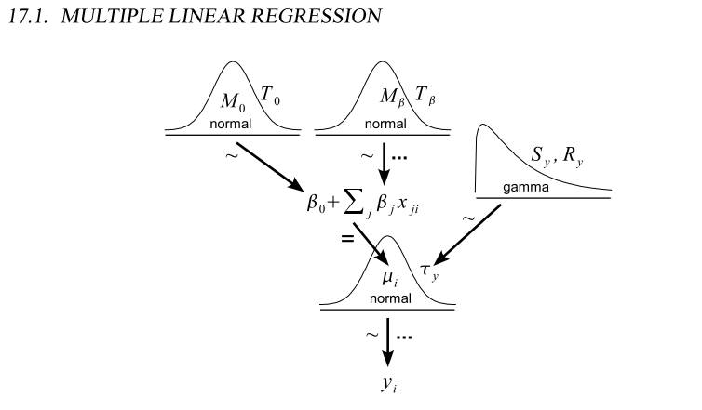
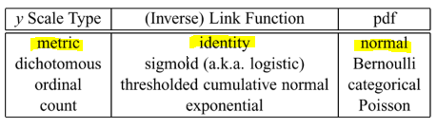
Notes:
Model from the book. Metric to metric.
Y from the GAPED study. 0 to 100 scale
Predictors from the Attention Tool. Evidence and intensity.
Evidence -3 to 3 scale
Intensity 0 to 1

Slide 12
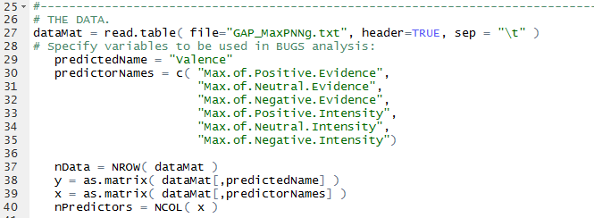
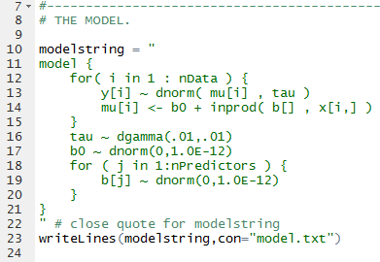

Slide 13
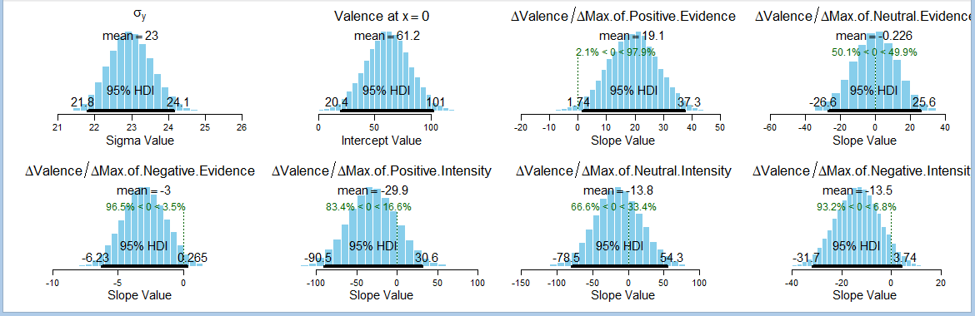
Valence
Notes:
Slope on Max.Pos.Evidence credibly above 0. Mean slope of 19.1. Valence scores rise by about 19.1 for every point increase in Max of Positive Evidence.
Max of neutral not being predictive. Expected.
Max of negative not credibly not 0. Trending on the negative side though with a mean slope of -3. Meaning valence drops by 3 points for every 1 point increase in my Negative evidence score.
Max Intensities not doing much for prediction of Valence
B0 : mean 61.2. Valence when all else at 0. Closeish to neutral. Expected. Neutral on the GAPED database was… next slide

Slide 14
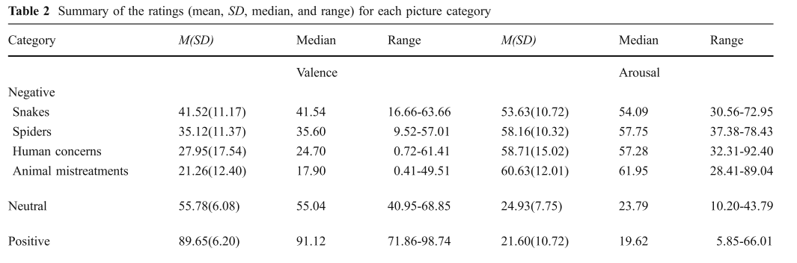
Notes:
The mean valence for Neutral was 55.7
Mean for neg. varies. 41. 22.
pos. 89
On to Arousal
Mean Pos 19.62
Neg ~55-60
Neutral 24

Slide 15
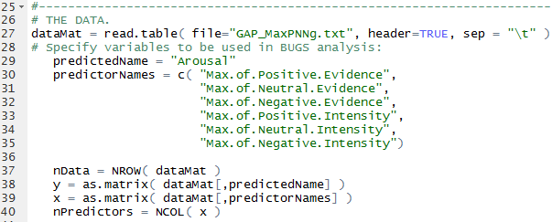
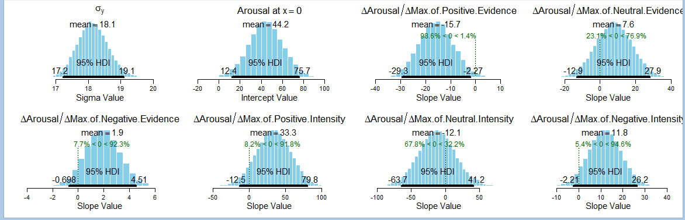
Arousal
Notes:
B0: when all parameters are 0, arousal predicted to be 44. ~ neutral.
Max Pos Evidence. Mean 15.7, credibly not 0. Arousal scores rise by about 15.7 for every point increase in Max of Positive Evidence.
Neutral ev. 0. fine
Neg ev. Trending positive this time. Makes sense. Arousal scores rise by ~2 for every point increase in max neg evidence. Higher max neg expression = higher arousal.
Intensities still include 0. might have expected those to be more significant.
Pos and negative are trending though. And trending positive. So more intensity=higher arousal.

Slide 16
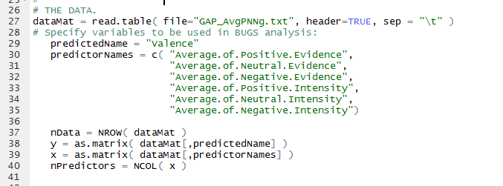
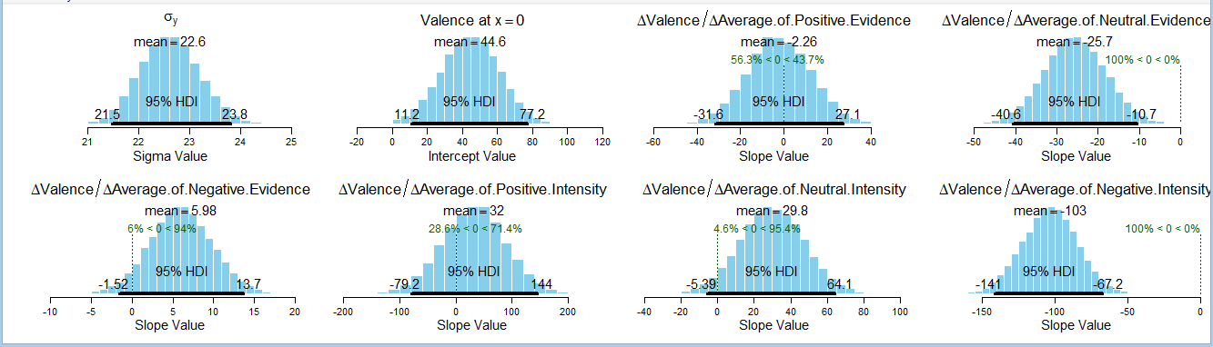
Valence
Notes:
B0. 44. was 61 for the max valence. Still close to 50 though
Avg of pos evidence doing nothing. This time neutral evidence average is being more predictive. And negatively. Valence scores decrease by about 26 for every point increase in Average of Neutral Evidence.
Kinda trending opposite direction for AvgNeg Evidence
Intensity:
The avg of the neg intensity
At -103. So Valence scores decrease by about 103 for every point increase in Average of Negative intensity . Makes sense. As my negative expression is very intense their score for the image is very negative.

Slide 17
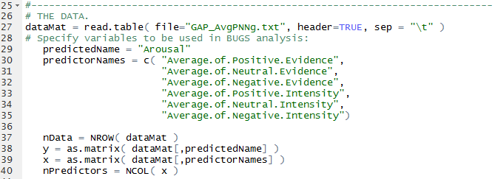
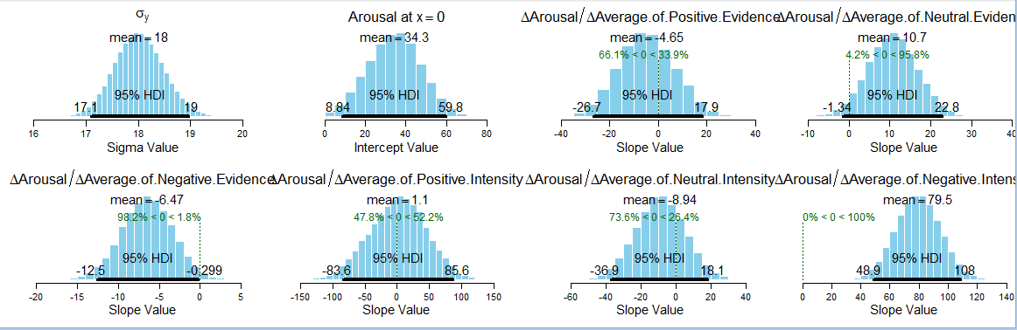
Arousal
Notes:
Neutral arousal was 24 in their study. Showing 34 at B0. close
Pos ev doing nothing.
Neutral ev maybe
Neg evidence doing something now. Credibly not 0. but barely
Arousal scores decrease by about 6 for every point increase in Average of Negative Evidence.
Negative intensity. Mean 79.5. Arousal scores increase by 80 for every point increase in average of negative intensity.
The negative images had arousal scores ~60. The positive images had arousal scores of 19.
Matches their images. Tells us something potentially about their image set. Not necessarily about the absolute normal arousal for positive and negative things. They had mostly calming images of babies or puppies for the positive images. They could have had someone triumphantly accepting the gold medal at the Olympics or something. Would have been more “exciting” and “stimulating” on their scale mayb.

Slide 18
Further directions
Compare first 10% vs last 10% of data set
Fatigue/boredom/frustration effect (2.5 hrs looking at 730 images, 4s/pic + interslides)
Split data into training/test sets
Analyze data by group (Animal mistreatment, snakes, positive, etc).
Group differences on prediction power of parameters?
Ability to predict category based on my reaction to image?
Analyze by emotion, rather than Positive, Negative, Neutral
Emotion time course information
More subjects
Investigate potential interactions of the metric predictors

Slide 19
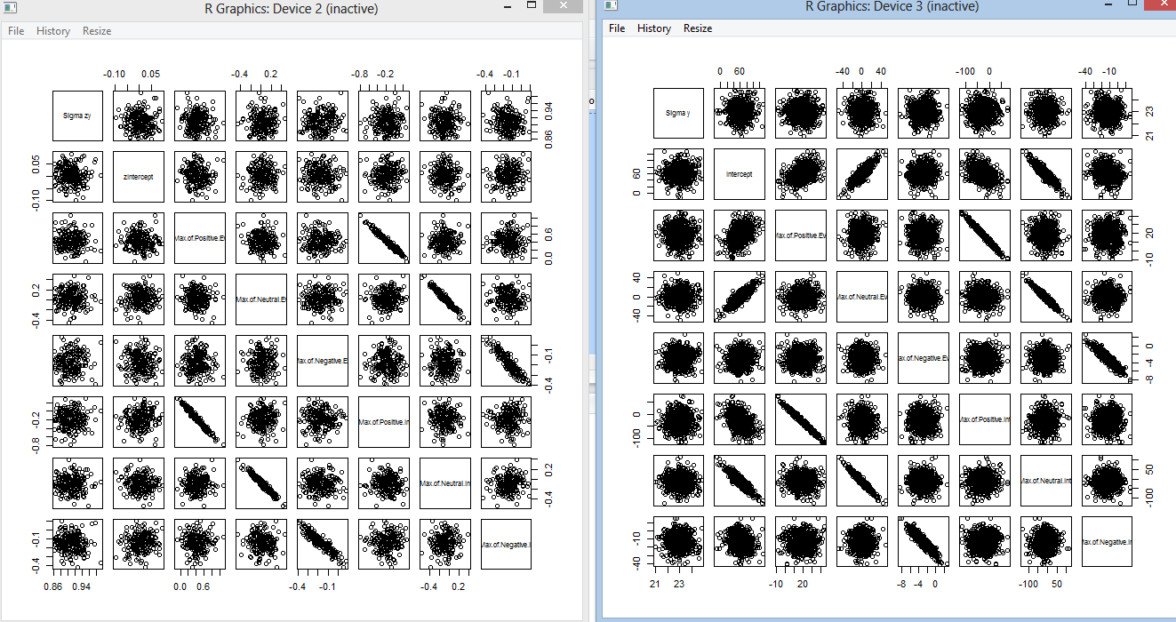
Notes:
interaction between some of the parameters?
Each parameter slope indicates what the change in valence would be if every other parameter were 0.

